Slide 1
Monte Carlo Option Pricing
Professor Philip Howard
howardpd@wfu.edu

Slide 2
Call Option
Gives the holder the right but not obligation to buy stock at predetermined strike price
Use options to hedge risk or speculate

Slide 3
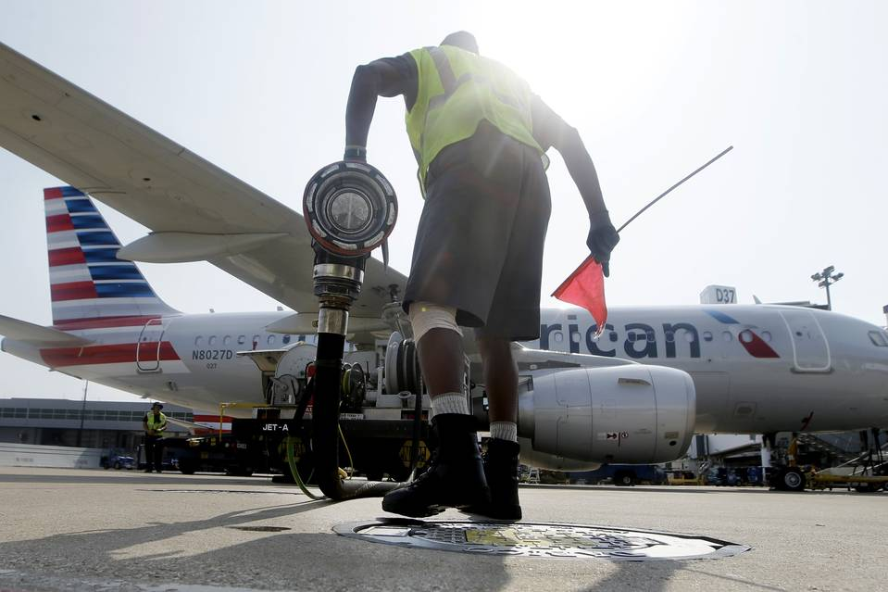
Airlines Pull Back on Hedging Fuel Costs
Fuel is a cost to airlines
Rising oil prices results in higher fuel costs
Airlines used options to hedge higher oil costs
Reappraisal of costly strategy comes after some carriers get burned by low oil prices

Slide 4
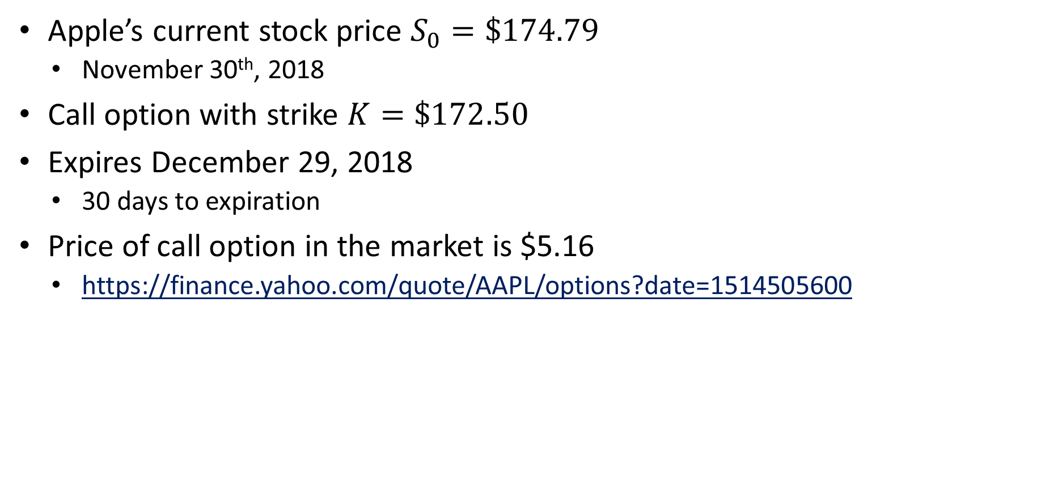
Call Option Example
Apple’s current stock price $S_{0}=\$174.79$
November 30th, 2018
Call option with strike $K=\$172.50$
Expires December 29, 2018
30 days to expiration
Price of call option in the market is $5.16
https://finance.yahoo.com/quote/AAPL/options?date=1514505600

Slide 5
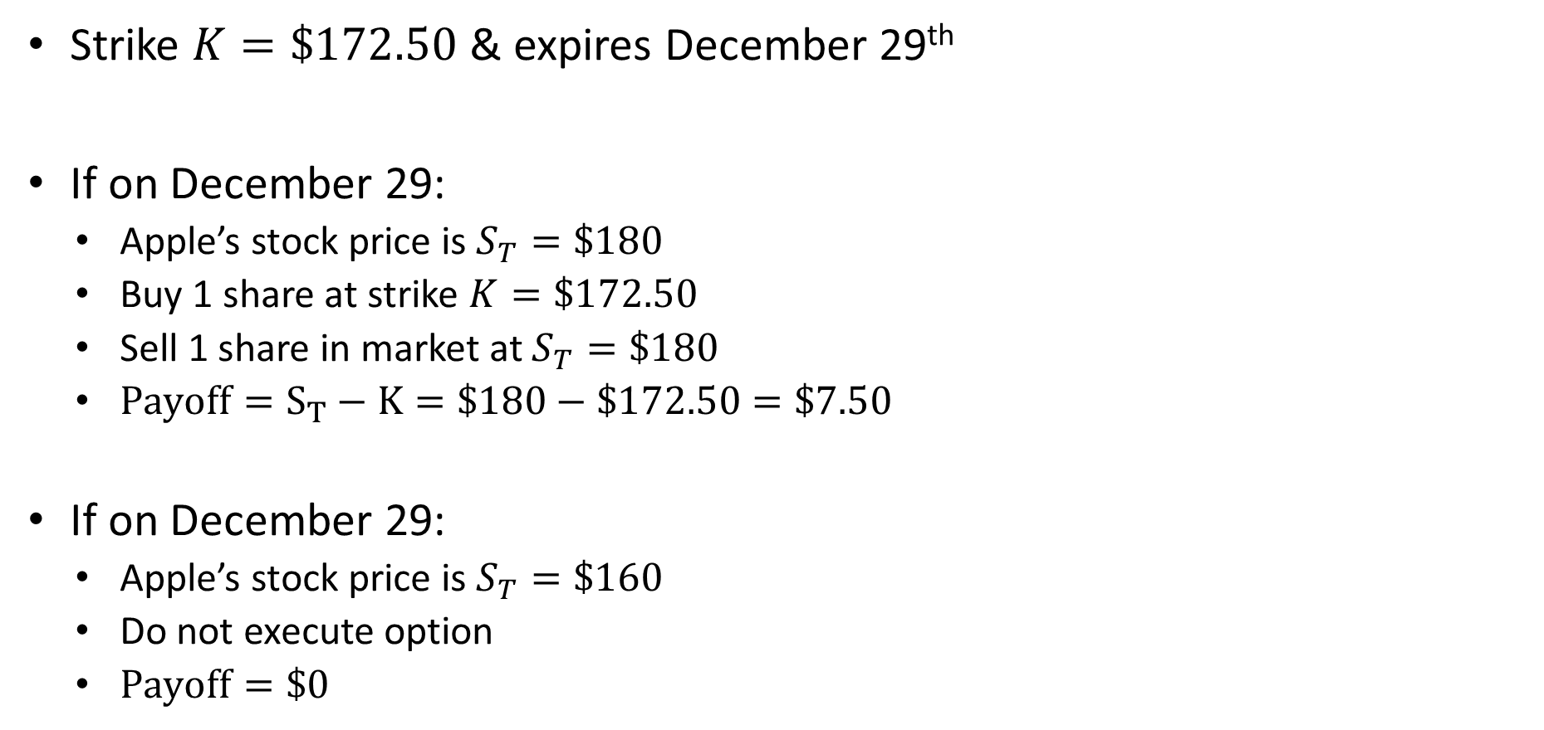
Call Option Example
Strike $K=\$172.50$ & expires December 29th
If on December 29:
Apple’s stock price is $S_{T}=\$180$
Buy 1 share at strike $K=\$172.50$
Sell 1 share in market at $S_{T}=\$180$
$Payoff=S_{T}−K=\$180−\$172.50=\$7.50$
If on December 29:
Apple’s stock price is $S_{T}=\$160$
Do not execute option
$Payoff=\$0$

Slide 6
Call Option Payoffs

Slide 7

Call Option Payoffs
$Payoff=max\left(S_{T}−K,0\right)$
Price of call option is the present value of expected future payoff
$$C_{0}=\frac{E\left[Payoff\right]}{e^{r_{f}}}$$

Slide 8
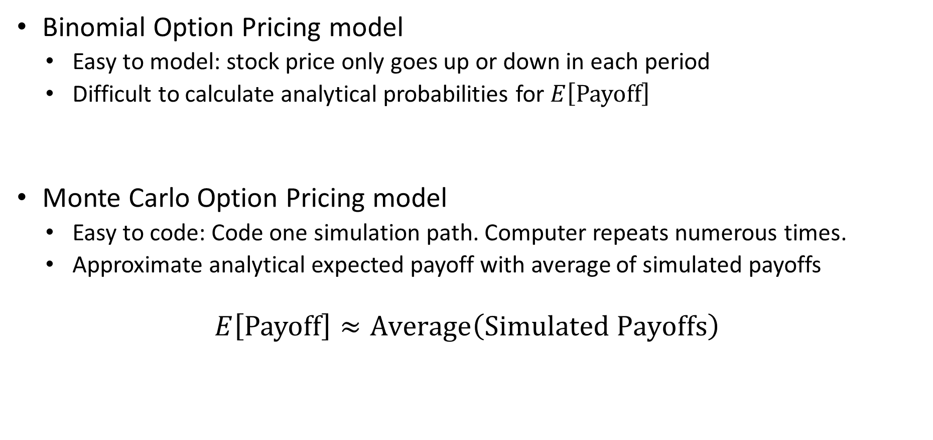
Call Option Pricing
Binomial Option Pricing model
Easy to model: stock price only goes up or down in each period
Difficult to calculate analytical probabilities for $E\left[Payoff\right]$
Monte Carlo Option Pricing model
Easy to code: Code one simulation path. Computer repeats numerous times.
Approximate analytical expected payoff with average of simulated payoffs
$$E\left[Payoff\right]≈Average\left(Simulated Payoffs\right)$$

Slide 9
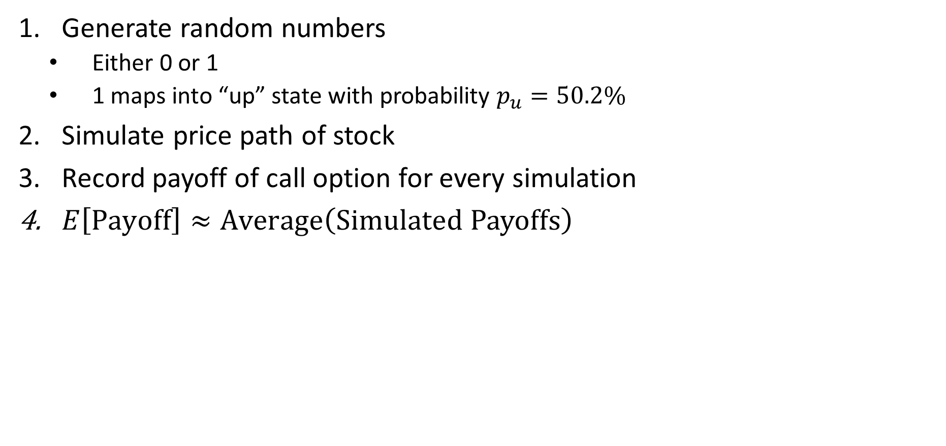
Monte Carlo Simulation Review
Generate random numbers
Either 0 or 1
1 maps into “up” state with probability $p_{u}=50.2\%$
Simulate price path of stock
Record payoff of call option for every simulation
$E\left[Payoff\right]≈Average\left(Simulated Payoffs\right)$

Slide 10
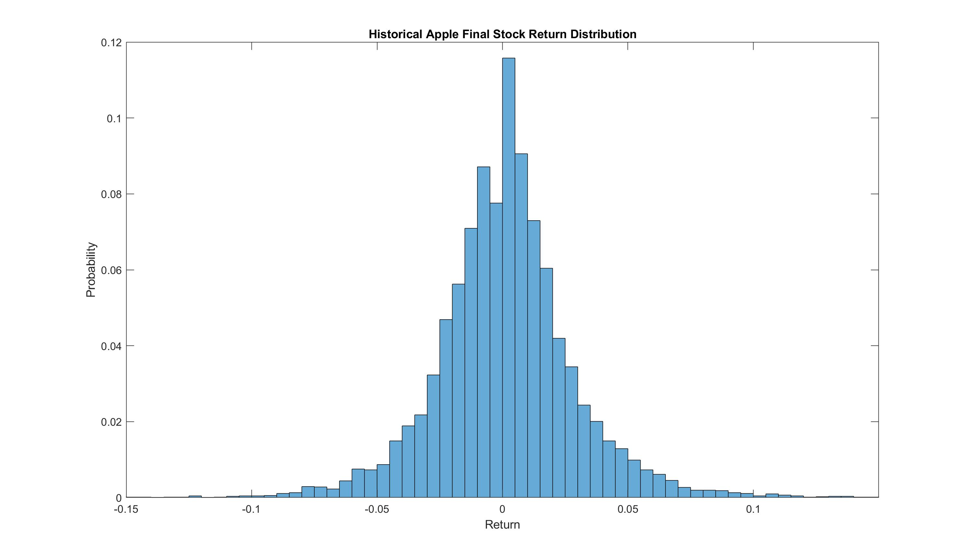

Slide 11
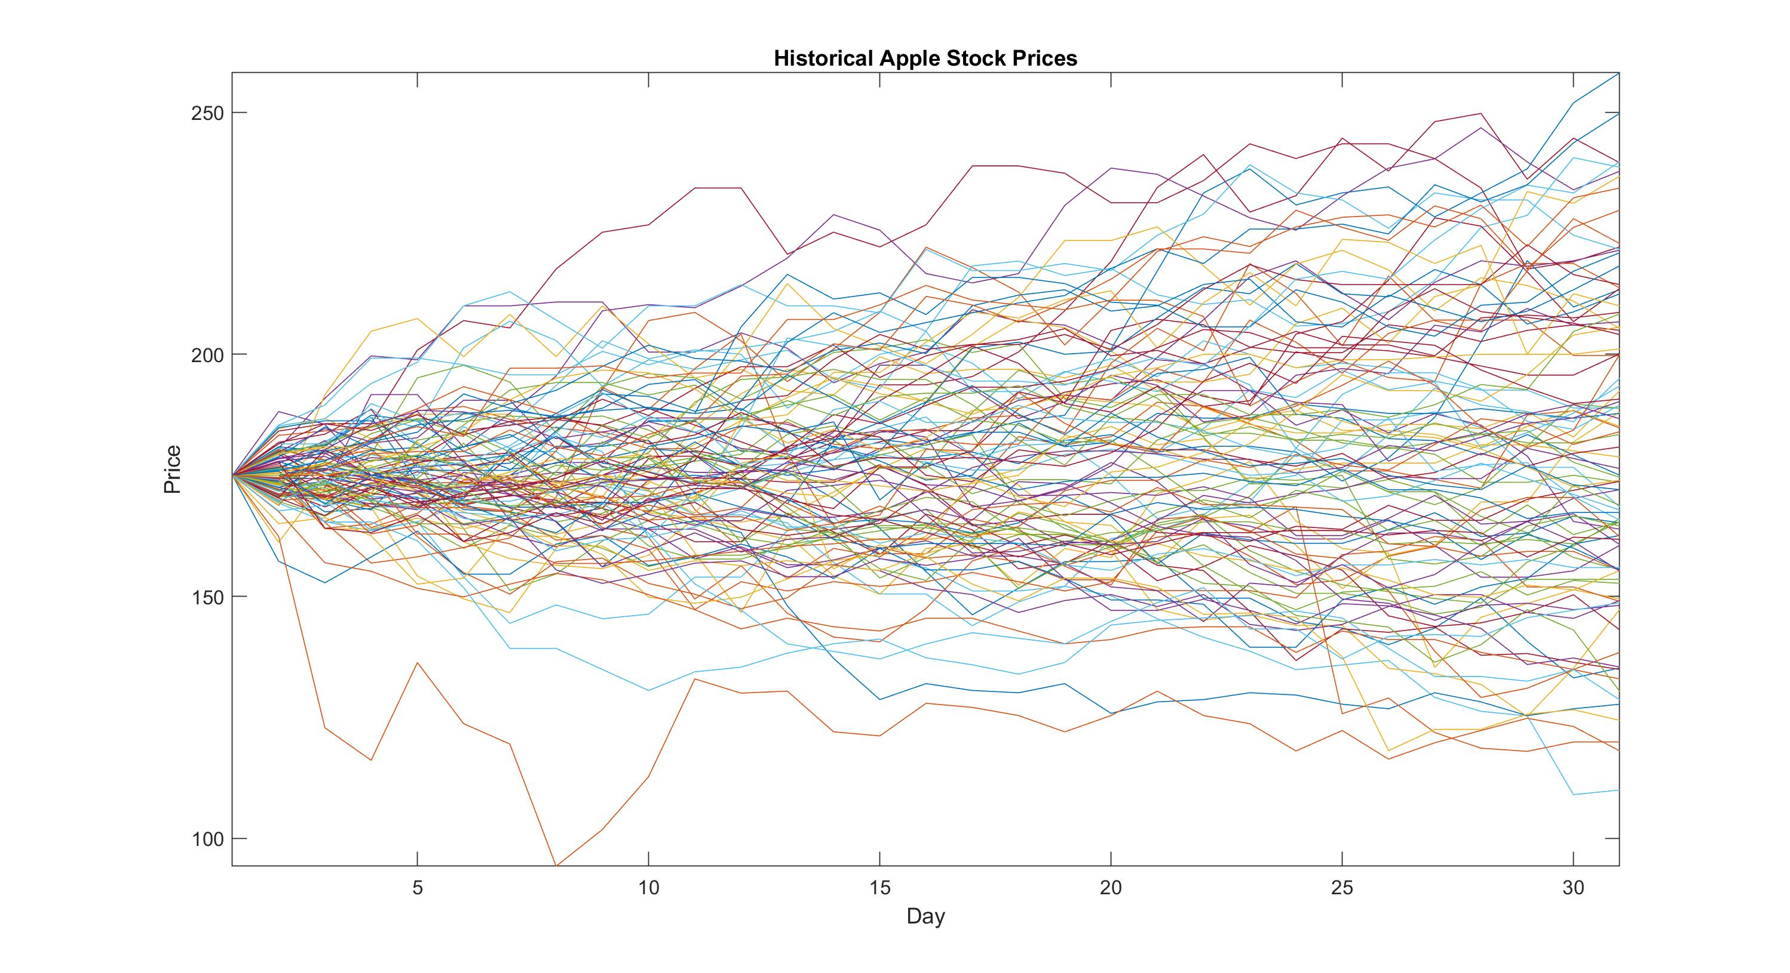

Slide 12
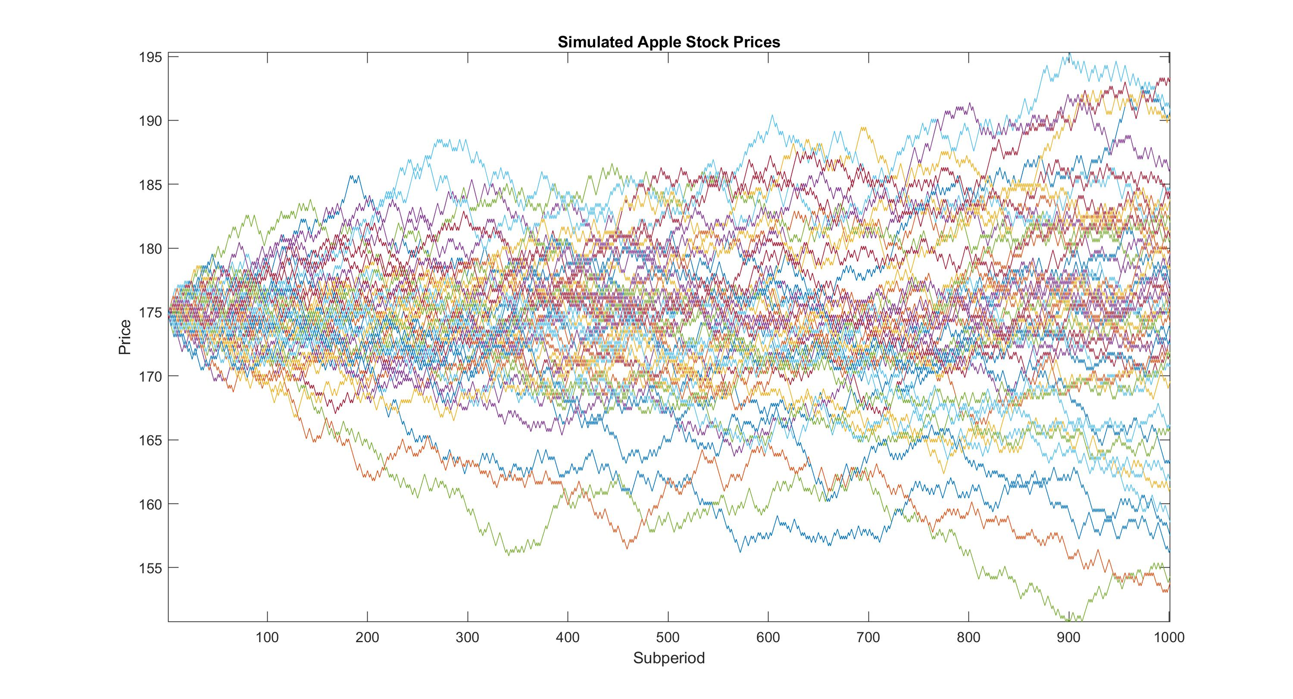

Slide 13
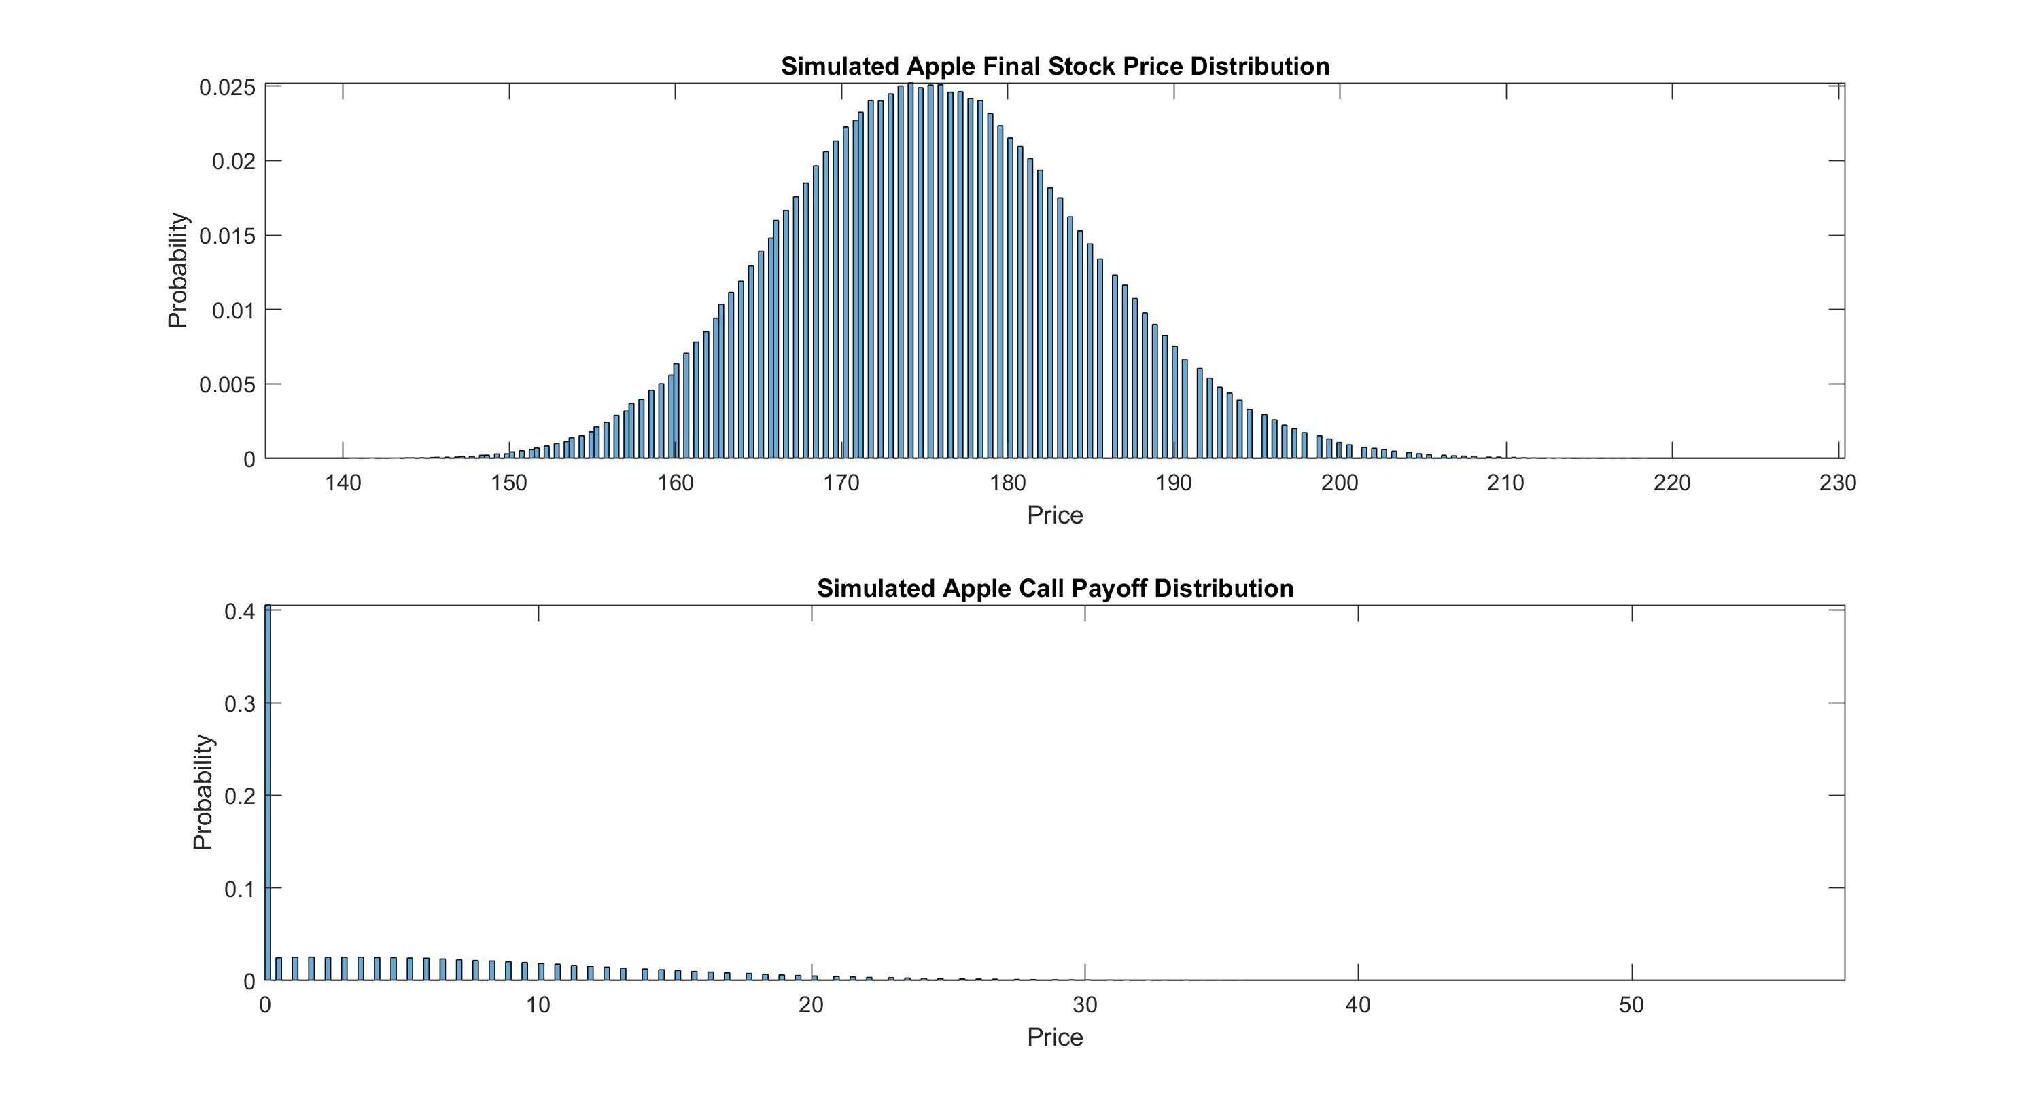

Slide 14
Sensitivity Analysis
What happens to the call option price as the volatility of stock returns increases? Why?
Option price increases as volatility increases
Get upside benefit of higher stock prices but no more downside benefit

Slide 15
History of Finance

Slide 16
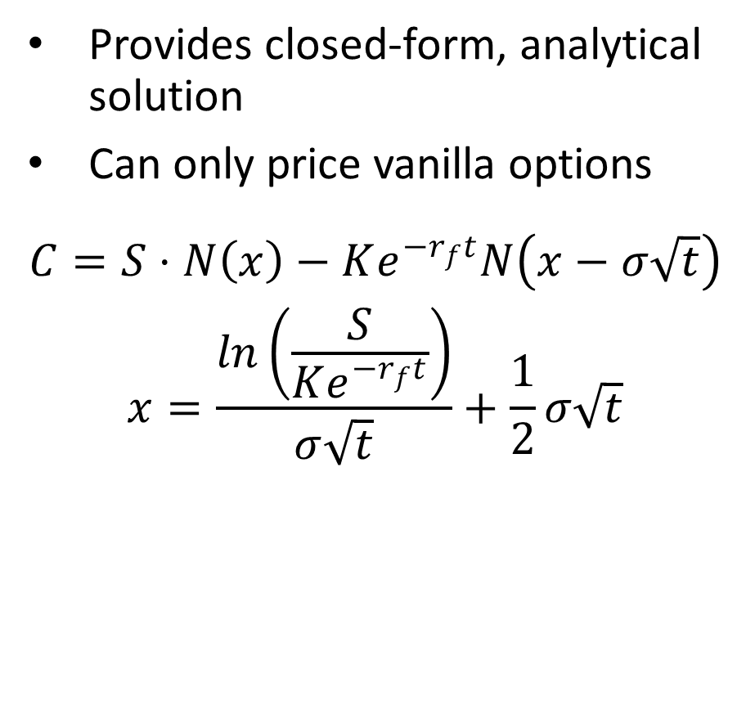
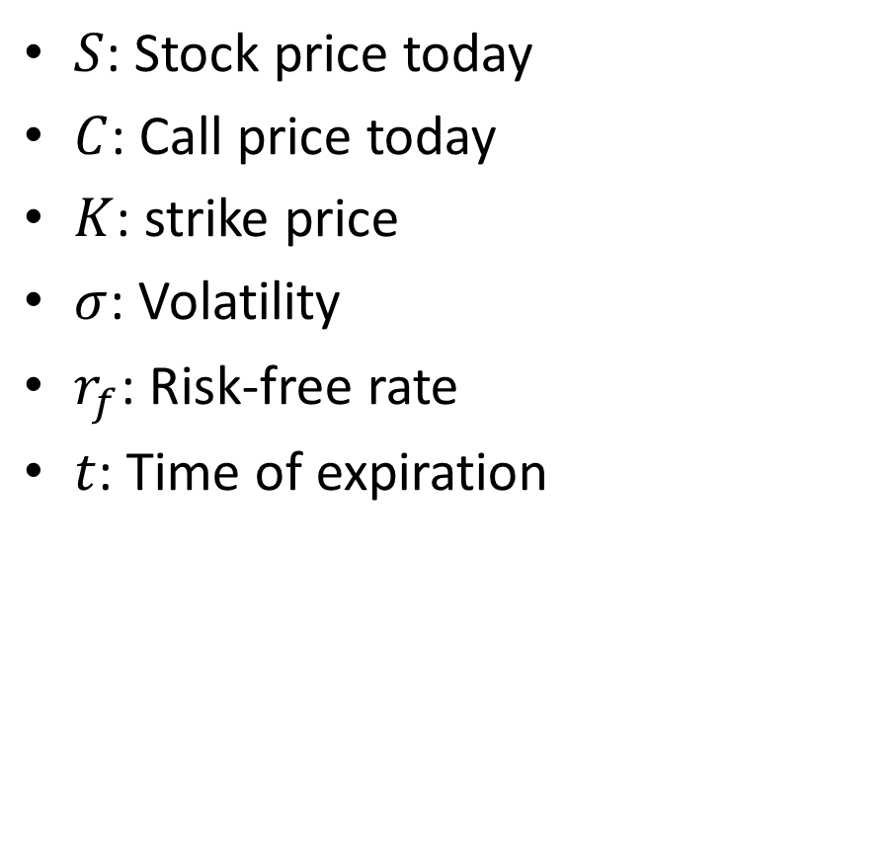
Black-Scholes Option Pricing Model
Provides closed-form, analytical solution
Can only price vanilla options
$$\begin{aligned}C=S⋅N\left(x\right)−Ke^{−r_{f}t}N\left(x−σ\sqrt{t}\right) \\ x=\frac{ln\left(\frac{S}{Ke^{−r_{f}t}}\right)}{σ\sqrt{t}}+\frac{1}{2}σ\sqrt{t}\end{aligned}$$
$S$: Stock price today
$C$: Call price today
$K$: strike price
$σ$: Volatility
$r_{f}$: Risk-free rate
$t$: Time of expiration

Slide 17

Exotic Option Pricing
European Call Option
Payoff depends on stock price at date of expiration
$$Payoff=max\left(S_{T}−K,0\right)$$
Asian Call Option
Payoff depends on average stock price over life of option
$$Payoff=max\left(Average\left(S_{t}\right)−K,0\right)$$

Slide 18
Exotic Option Pricing
No longer closed form solutions from Black-Scholes
Just as easy to price using Monte Carlo simulation
Price of Asian option is less than price of European option. Why?
Average stock price is less volatile than final stock price
Option price increases as volatility increases

Slide 19
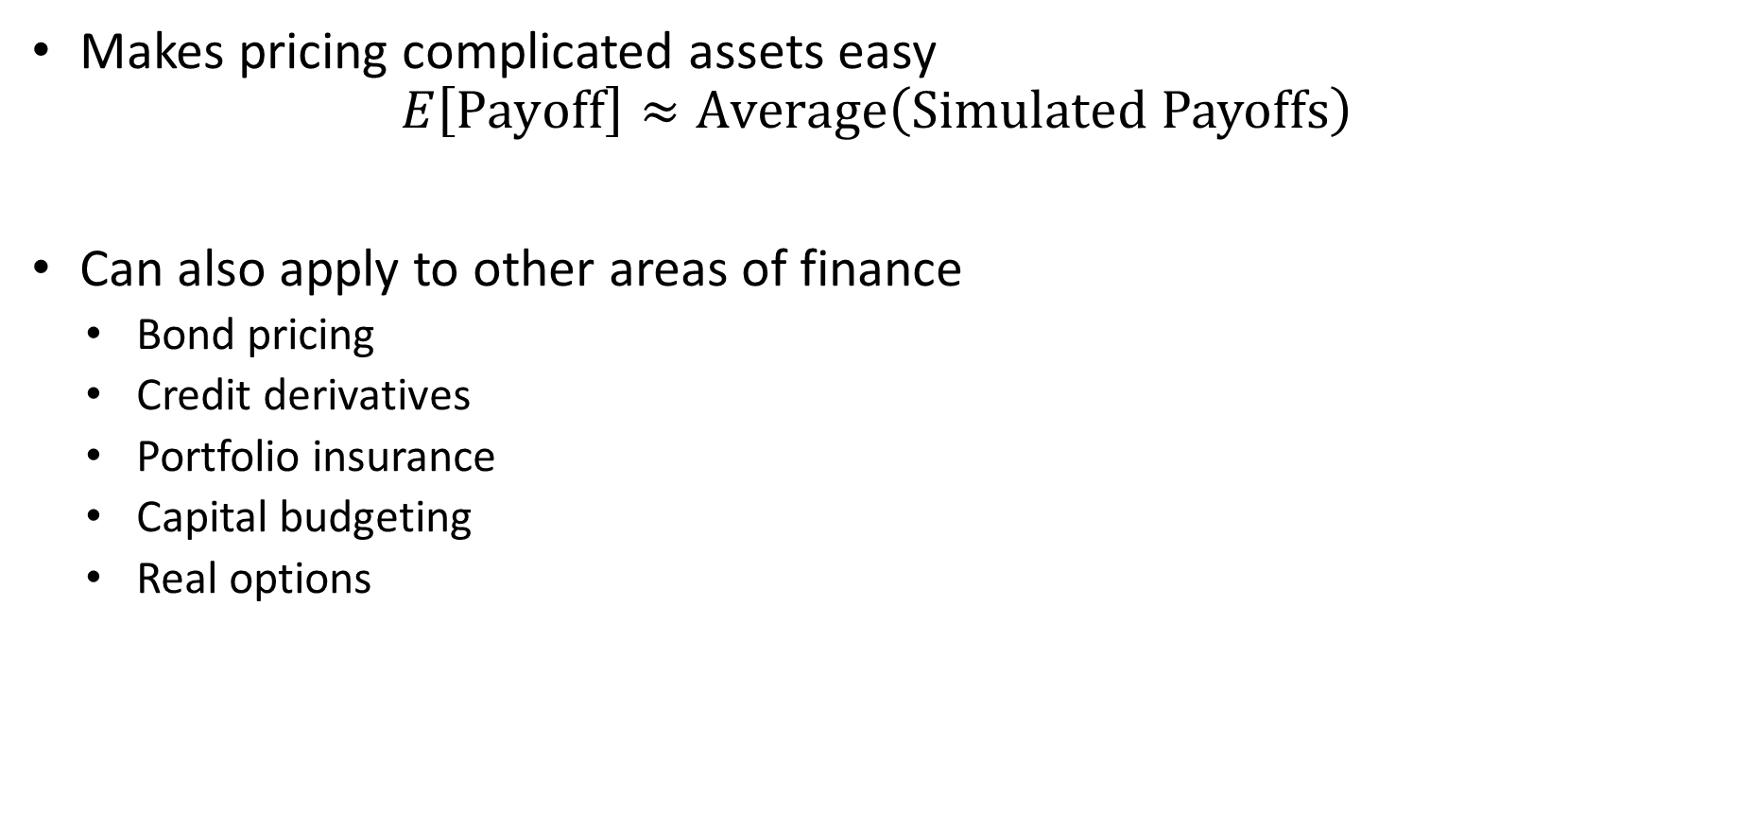
Monte Carlo Simulation
Makes pricing complicated assets easy
$$E\left[Payoff\right]≈Average\left(Simulated Payoffs\right)$$
Can also apply to other areas of finance
Bond pricing
Credit derivatives
Portfolio insurance
Capital budgeting
Real options

Slide 20
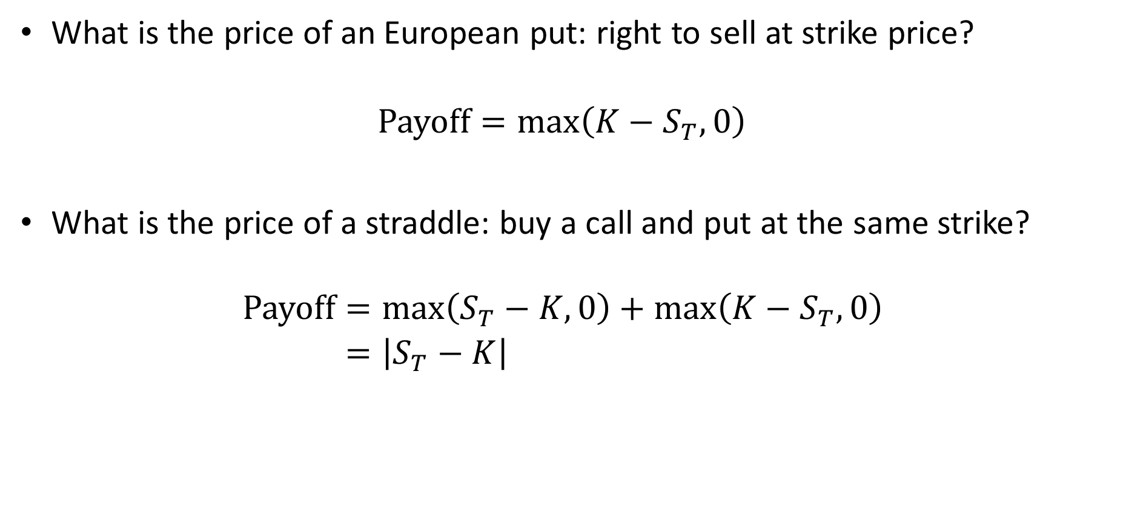
Extra
What is the price of an European put: right to sell at strike price?
$$Payoff=max\left(K−S_{T},0\right)$$
What is the price of a straddle: buy a call and put at the same strike?
$$\begin{aligned}Payoff&=max\left(S_{T}−K,0\right)+max\left(K−S_{T},0\right) \\ &=\left|S_{T}−K\right|\end{aligned}$$

Slide 21
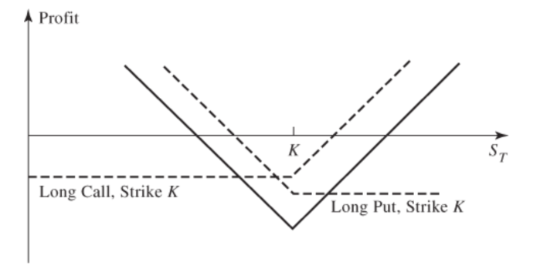
Payoff of Straddle

